Slide 1
Decision Tree

Slide 2
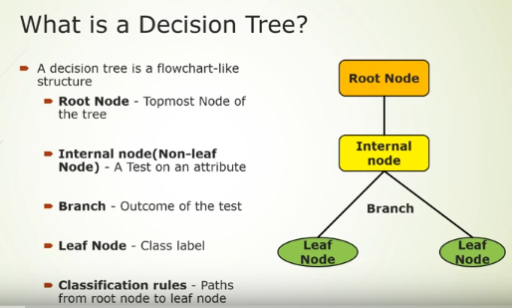

Slide 3
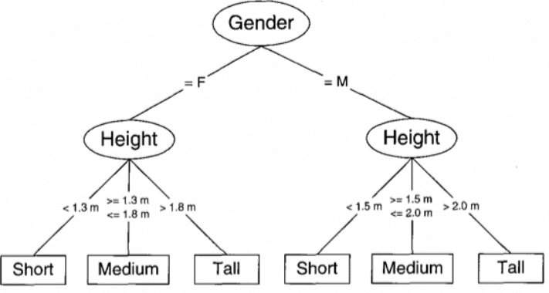
Example

Slide 4
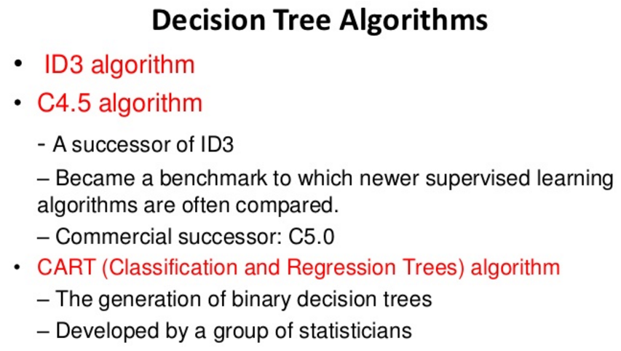

Slide 5
How does a tree split?

Slide 6
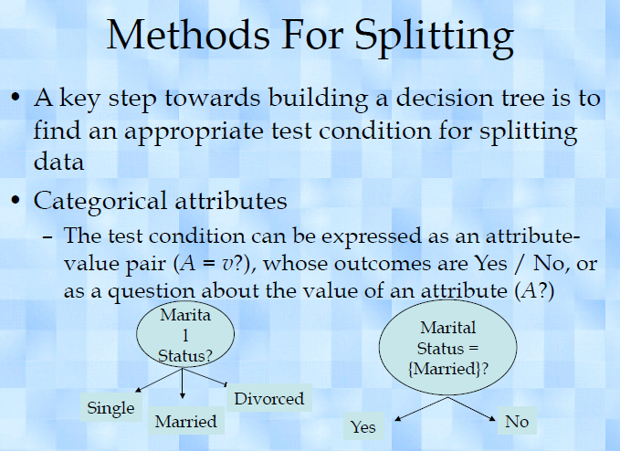

Slide 7
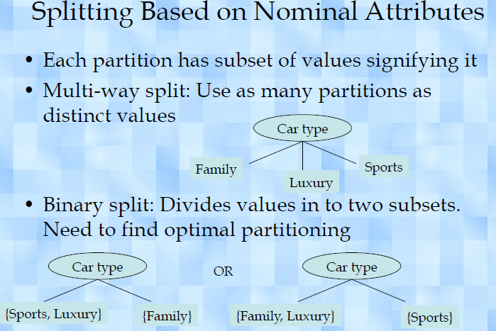

Slide 8
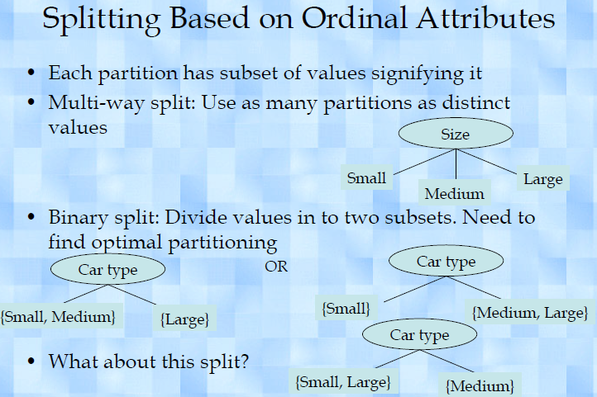

Slide 9
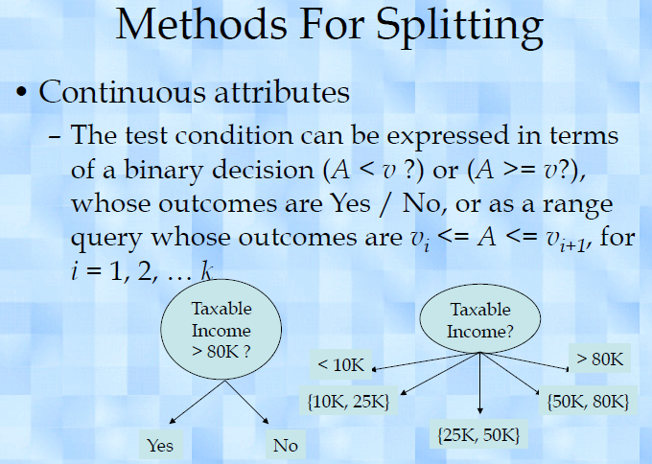

Slide 10
Attribute Measures
Information Gain
Gain Ratio
Gini Index

Slide 11
Understanding Decision Tree with an Example

Slide 12
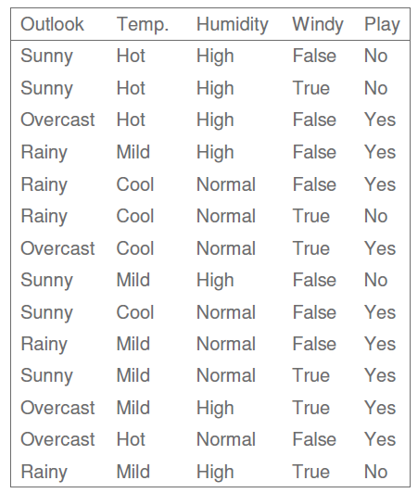

Slide 13
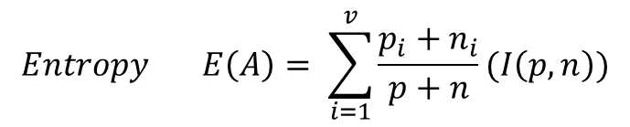

Steps
1. Calculate the Overall Information Gain / Entropy of the dataset using
2. Calculate the Entropy of the every attribute in the dataset
3. Calculate the Overall Gain to identify the split attribute.
$$Information Gain = I\left(p,n\right)= \frac{−p}{p+n}\log_{2}\left(\frac{p}{p+n}\right)−\frac{n}{p+n}\log_{2}\left(\frac{n}{p+n}\right)$$
$$Entropy E\left(A\right)= \sum_{i=1}^{v}{\frac{p_{i}+n_{i}}{p+n}(I\left(p,n\right))}$$
$$Gain\left(A\right)= I\left(p,n\right)−E(A)$$

Slide 14
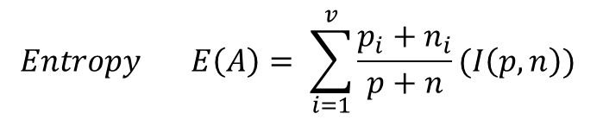

$$Information Gain = I\left(p,n\right)= \frac{−p}{p+n}\log_{2}\left(\frac{p}{p+n}\right)−\frac{n}{p+n}\log_{2}\left(\frac{n}{p+n}\right)$$
$$Entropy E\left(A\right)= \sum_{i=1}^{v}{\frac{p_{i}+n_{i}}{p+n}(I\left(p,n\right))}$$
$$Gain\left(A\right)= I\left(p,n\right)−E(A)$$

Slide 15
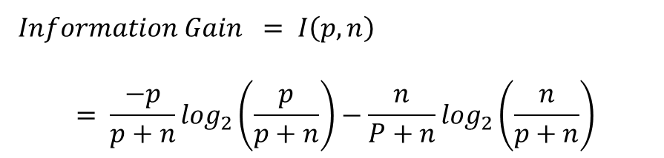
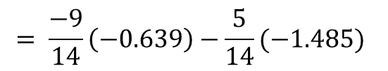
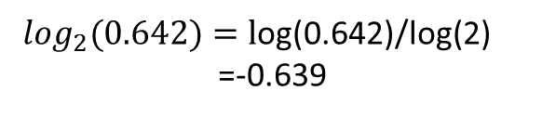

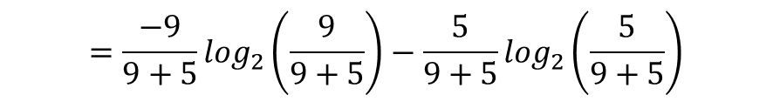
P:yes =9 n:no =5
$$Information Gain = I\left(p,n\right)$$
$$= \frac{−p}{p+n}\log_{2}\left(\frac{p}{p+n}\right)−\frac{n}{P+n}\log_{2}\left(\frac{n}{p+n}\right)$$
$$=\frac{−9}{9+5}\log_{2}\left(\frac{9}{9+5}\right)−\frac{5}{9+5}\log_{2}\left(\frac{5}{9+5}\right)$$
$$=\frac{−9}{9+5}\log_{2}\left(0.642\right)−\frac{5}{9+5}\log_{2}\left(0.357\right)$$
$\log_{2}(0.642)=l$og(0.642)/log(2)
=-0.639
$$= \frac{−9}{14}\left(−0.639\right)−\frac{5}{14}(−1.485)$$
I(9,5) = 0.940

Slide 16
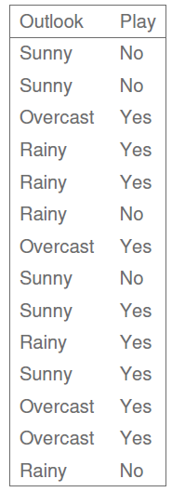


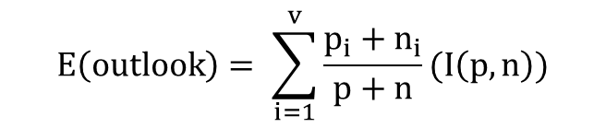

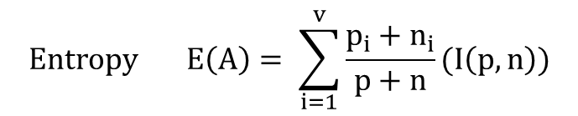
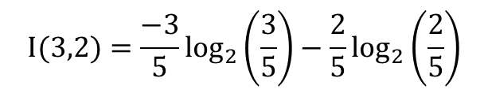
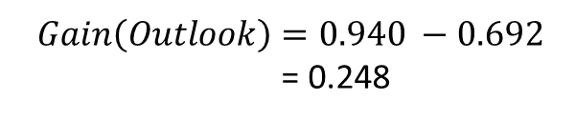
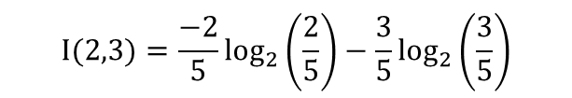

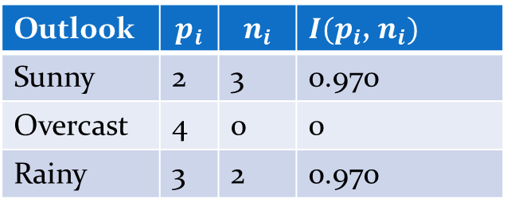


$$Entropy E\left(A\right)= \sum_{i=1}^{v}{\frac{p_{i}+n_{i}}{p+n}(I\left(p,n\right))}$$
P:yes =9 n:no =5
I(9,5) = 0.940
$$E\left(outlook\right)= \sum_{i=1}^{v}{\frac{p_{i}+n_{i}}{p+n}(I\left(p,n\right))}$$
Entropy for Outlook
Outlook | $$p_{i}$$ | $$n_{i}$$ | $I(p_{i}$, $n_{i})$
Sunny | 2 | 3 | 0.970
Overcast | 4 | 0 | 0
Rainy | 3 | 2 | 0.970
$= \frac{5}{14}\left(0.970\right)+\frac{4}{14}(0)$+$\frac{5}{14}(0.970)$
= 0.692
$$Gain\left(A\right)= I\left(p,n\right)−E(A)$$
$$I(2,3)=\frac{−2}{5}\log_{2}\left(\frac{2}{5}\right)−\frac{3}{5}\log_{2}\left(\frac{3}{5}\right)$$
$$Gain\left(Outlook\right)= I\left(9,5\right)−E(Outlook)$$
I(2,3) = 0.528+0.441 = 0.970
$$Gain\left(Outlook\right)=0.940 −0.692$$
= 0.248
I(4,0) = 0
$$I(3,2)=\frac{−3}{5}\log_{2}\left(\frac{3}{5}\right)−\frac{2}{5}\log_{2}\left(\frac{2}{5}\right)$$
$Gain\left(Temperature\right)=$ 0.029
$Gain\left(Humidity\right)=$ 0.151
I(3,2) = 0.441+0.528 = 0.970
$Gain\left(Wind\right)=$ 0.048

Slide 17
P: yes =9
n: No = 5
I(9,5) = 0.940
Gain (Outlook) = 0.248
Gain( Temp.) = 0.029
Gain (Humidity) = 0.151
Gain (Wind) = 0.048
Outlook
Sunny
overcast
Rainy

Slide 18
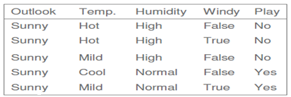
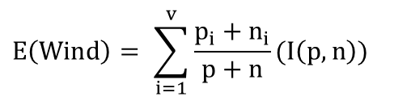
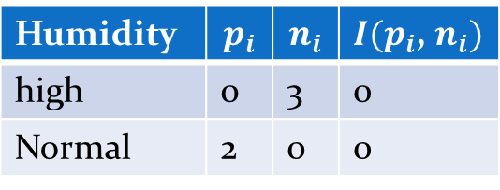
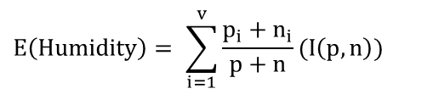
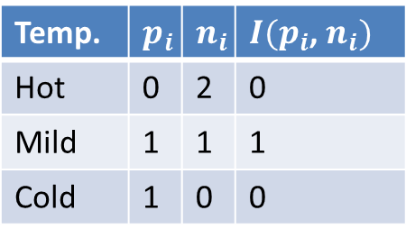
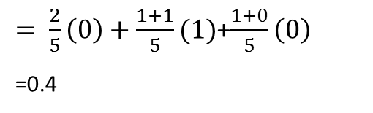
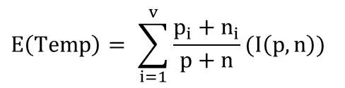
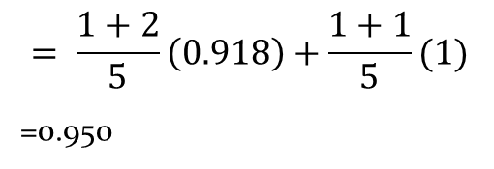
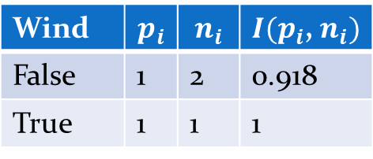
Entropy for Temperature
Entropy for Humidity
Entropy for Wind
P=2 n=3
P=2 n=3
P=2 n=3
Temp. | $$p_{i}$$ | $$n_{i}$$ | $I(p_{i}$, $n_{i})$
Hot | 0 | 2 | 0
Mild | 1 | 1 | 1
Cold | 1 | 0 | 0
Humidity | $$p_{i}$$ | $$n_{i}$$ | $I(p_{i}$, $n_{i})$
high | 0 | 3 | 0
Normal | 2 | 0 | 0
Wind | $$p_{i}$$ | $$n_{i}$$ | $I(p_{i}$, $n_{i})$
False | 1 | 2 | 0.918
True | 1 | 1 | 1
$$E\left(Temp\right)= \sum_{i=1}^{v}{\frac{p_{i}+n_{i}}{p+n}(I\left(p,n\right))}$$
$$E\left(Humidity\right)= \sum_{i=1}^{v}{\frac{p_{i}+n_{i}}{p+n}(I\left(p,n\right))}$$
$$E\left(Wind\right)= \sum_{i=1}^{v}{\frac{p_{i}+n_{i}}{p+n}(I\left(p,n\right))}$$
$= \frac{2}{5}\left(0\right)+\frac{1+1}{5}(1)$+$\frac{1+0}{5}\left(0\right)$
=0.4
$$= \frac{1+2}{5}\left(0.918\right)+\frac{1+1}{5}(1)$$
=0.950
=0
Gain(Sunny,Humi.,) = 0.970-0 = 0.970
Gain(Sunny,Temp.) = 0.970-0.4 = 0.57
Gain(Sunny,Wind) = 0.970-0.950= 0.02

Slide 19
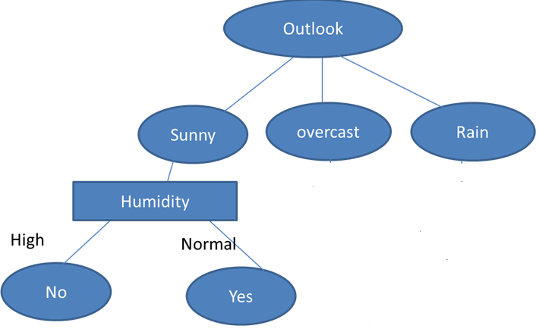
Gain(Sunny,Temp.) = 0.57
Gain(Sunny,Humi.,) = 0.970
Gain(Sunny,Wind) = 0.02

Slide 20
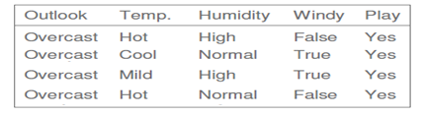
Outlook
Sunny
overcast
Rain
Humidity
Yes
High
Normal
No
Yes

Slide 21
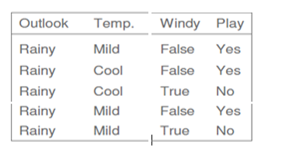
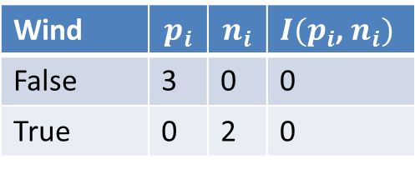
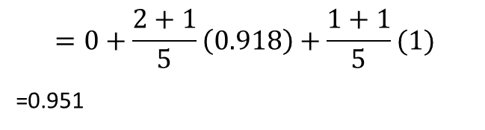
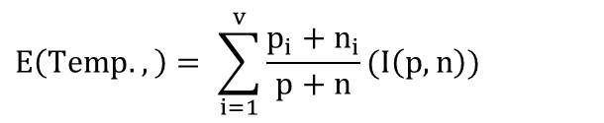
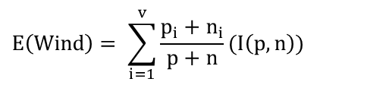
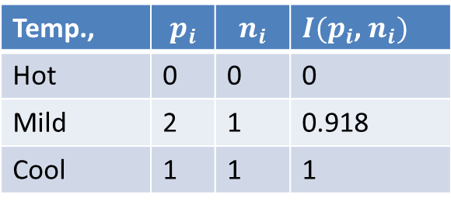
Entropy for Wind
Entropy for Temperature
P=3 n=2
P=3 n=2
Wind | $$p_{i}$$ | $$n_{i}$$ | $I(p_{i}$, $n_{i})$
False | 3 | 0 | 0
True | 0 | 2 | 0
Temp., | $$p_{i}$$ | $$n_{i}$$ | $I(p_{i}$, $n_{i})$
Hot | 0 | 0 | 0
Mild | 2 | 1 | 0.918
Cool | 1 | 1 | 1
$$E\left(Wind\right)= \sum_{i=1}^{v}{\frac{p_{i}+n_{i}}{p+n}(I\left(p,n\right))}$$
$$E\left(Temp.,\right)= \sum_{i=1}^{v}{\frac{p_{i}+n_{i}}{p+n}(I\left(p,n\right))}$$
=0
$$=0+\frac{2+1}{5}\left(0.918\right)+\frac{1+1}{5}(1)$$
=0.951
Gain(Rainy,Wind) = 0.970
Gain(Rainy,Temp.,) = 0.970-0.951
= 0.019

Slide 22
Outlook
Gain(Train,Wind) = 0.970
Gain(rain,Temp.,) = 0.019
Sunny
overcast
Rain
Humidity
Yes
Wind
High
Normal
No
False
True
Yes
Yes
No

Slide 23
Outlook
Sunny
overcast
Rain
Humidity
Yes
Wind
High
Normal
No
False
True
Yes
Yes
No

